Slide 1
Interfacing Android Things with an Arduino Real-World Experience and Observations
Timothy J. Salo
Salo IT Solutions, Inc.
salo <at> saloits <dot> com

Slide 2
Interfacing Android Things
Android Things “Makes embedded development as simple as mobile development has become”
- Dave Smith, Google I/O 2017

Slide 3
Interfacing Android Things
Objectives
Better understand Android Things’ applicability:
Does Android Things gracefully support typical embedded tasks?
Directly manipulate hardware devices?
Handle interrupts and asynchronous events?
Do Java Threads easily support full-duplex, interrupt-driven devices?

Slide 4
Interfacing Android Things
Presentation
Presentation and Code
<https://github.com/tjsalo/>
Presentation
<https://www.saloits.com/papers/InterfacingAndroidThingsIoTDevfest2018.pdf>

Slide 5
Interfacing Android Things
Contents
The project
Observations, lessons learned, and opinions

Slide 6
Interfacing Android Things: The Project
The Project
Interconnect:
Raspberry Pi running Android Things and Pololu A-Star
Transfer:
Temperature sensor data from A-Star to RPi
Display:
Temperature sensor data on web page

Slide 7
Interfacing Android Things: The Project
Android Things / Arduino Interfacing
Temp Values
Raspberry Pi
A-Star Arduino
Async Cable
Web Browser
HTTP
I2C Bus
SPI Bus
Temperature Sensor

Slide 8
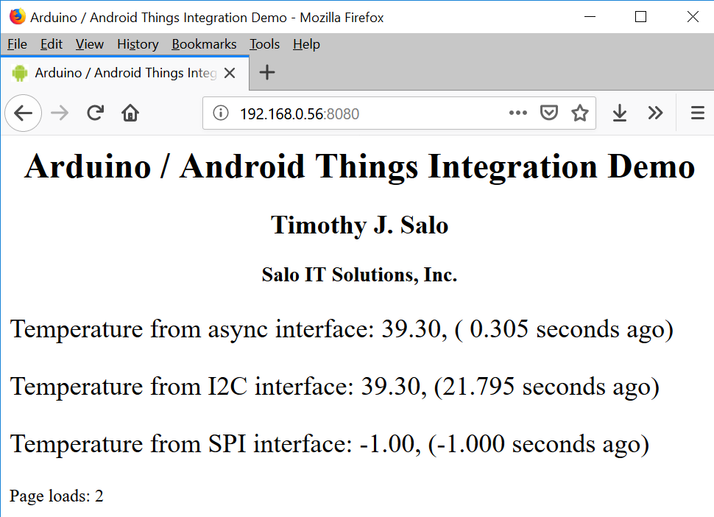
Interfacing Android Things: The Project
SSID: AndroidThings
http://192.168.0.56:8080

Slide 9
Interfacing Android Things: Hardware
Raspberry Pi
Quad Core Broadcom BCM2837 64-bit CPU
1 GB RAM
64 GB Flash
1.2 GHz
3.3 V logic
Android Things
NanoHttpd
Pololu A-Star 32U4
Atmel ATmega32U4 8-bit MCU
2.5 KB RAM
32 KB flash
16 MHz clock
5 V logic
No operating system
Custom C code

Slide 10
Interfacing Android Things: Hardware
Raspberry Pi
Quad Core Broadcom BCM2837 64-bit CPU
1 GB RAM (x 400,000)
64 GB Flash (x 2,000,000)
1.2 GHz (x 75)
3.3 V logic
Android Things
NanoHttpd
Pololu A-Star 32U4
Atmel ATmega32U4 8-bit MCU
2.5 KB RAM
32 KB flash
16 MHz clock
5 V logic
No operating system
Custom C code

Slide 11
Interfacing Android Things: Hardware
Connecting Raspberry Pi / A-Star Arduino
A-Star has Raspberry Pi Bridge
40-pin Raspberry Pi GPIO connector
But…
Raspberry Pi uses 3.3 V logic
A-Star uses 5 V logic

Slide 12
Interfacing Android Things: Hardware
Connecting Raspberry Pi / A-Star Arduino
Therefore:
Level converters required on signal pins
Furthermore:
Only I2C signals actually connected to 40-pin connector
with level converters
Rest of signal pins not connected!

Slide 13
Interfacing Android Things: Interfaces
Communications interfaces
Async | I2C | SPI
Full-Duplex | Half-Duplex | Full-Duplex
Peer-to-Peer | Master/Slave | Master/Slave
Asynchronous (no clock signal) | Synchronous (clock signal) | Synchronous (clock signal)

Slide 14
Interfacing Android Things: Interfaces
Async Link
Serial asynchronous link
Two data signals
Transmit data
Receive data

Slide 15
Interfacing Android Things: Interfaces
Async Link
Raspberry Pi
Arduino
Transmit Data
Receive Data
Receive Data
Transmit Data
Note: Ground not shown.

Slide 16
Interfacing Android Things: Interfaces
I2C Protocol
Inter-integrated Circuit (I2C) Protocol
Two signals:
Serial data (SDA)
Serial clock (SCL)

Slide 17
Interfacing Android Things: Interfaces
I2C Protocol
I2C Master
I2C Slave
Raspberry Pi
Arduino
SDA
SDA
SCL
SCL
Note: Ground not shown.

Slide 18
Interfacing Android Things: Interfaces
Serial Peripheral Interface (SPI) bus
Serial bus used in embedded systems
Master / Slave operation
Full duplex (sort of – still Master/Slave)
I/O operation swaps value of a register in the Master and the value of a register in the Slave
Can delineate frames

Slide 19
Interfacing Android Things: Interfaces
Serial Peripheral Interface (SPI) bus
SPI Master
SPI Slave
MOSI
MOSI
Raspberry Pi
Arduino
Register
Register
MISO
MISO
SPI I/O operation swaps Master register and Slave Register values. (Actually, performs a bit-wise end-around-shift.)

Slide 20
Interfacing Android Things: Interfaces
Serial Peripheral Interface (SPI) bus
Android Things supports two data transfer modes:
Half-duplex data transfer
Full-duplex data transfer
Remember: data transfer controlled by Master

Slide 21
Interfacing Android Things: Interfaces
Serial Peripheral Interface (SPI) bus
SPI Master
SPI Slave
MOSI
MOSI
Raspberry Pi
Arduino
MISO
MISO
SCLK
SCLK
~SS
~SS
Note: Ground not shown.

Slide 22
Interfacing Android Things: Interfaces
Serial Peripheral Interface (SPI) bus
SPI Master
SPI Slave
MOSI
MOSI
Raspberry Pi
Arduino
Level Shifter
MISO
MISO
Level Shifter
SCLK
SCLK
Level Shifter
~SS
~SS
Level Shifter
Note: Soldering probably required

Slide 23
Interfacing Android Things: Communications
Communications “Protocol”
Messages are ASCII strings, terminated by /n
Master
Slave
hello: nnnnn
ack: nnnnn
send: temp
temp: nn.n

Slide 24
Interfacing Android Things: Communications
Timeout
Idle
Timeout
Tx: hello <seq>
Hello Sent
Send Sent
Rx: ack <seq>
Rx: temp <value>
Tx: send temp
Link Established

Slide 25
Interfacing Android Things: Software
Typical Embedded Software Architecture
Update clock (e.g., millisecond clock)
While (true):
Executing pending tasks
Process expired timers (execute tasks)
Handle interrupts
Manage peripherals / communications / clock/ …

Slide 26
Interfacing Android Things: Software
Planned Android Things Software Architecture
Main Thread:
Android stuff
Fire up other threads
Create web pages
A bit of coordination
One Thread per physical interface
Manage link, communications

Slide 27
Interfacing Android Things: Project Results
Project Results
Implementation results decidedly mixed
Some stuff worked, some stuff didn’t
Async Interface works well
I2C interface largely works
RPi hardware bug (I2C clock stretching)?
SPI interface barely works
Noisy connections to level shifters?

Slide 28
Interfacing Android Things: Observations
Observations
Android Things ecosystem
What is “embedded programming”?
Java Thread and asynchronous events
Java String
Hardware state visibility
Low-level development
Mobile developers don’t…
Whither Android Things?

Slide 29
Interfacing Android Things: Observations
Caveats
I am not an Android developer
I am not a Java programmer
I am not an electrical engineer
Long ago, I was an assembly language systems programmer

Slide 30
Interfacing Android Things: Observations
Android Things Ecosystem
The Android Things ecosystem has many nice capabilities
Android Studio
Leverage Android developer expertise / documentation / …
Leverage Android code base / examples / …
Rich IDE
adb
…

Slide 31
Interfacing Android Things: Observations
Android Things Ecosystem
The Android Things ecosystem has many nice capabilities
Over-the-air (OTA) software updates
Addresses one of the more vexing IoT problems

Slide 32
Interfacing Android Things: Observations
Android Things Ecosystem
The Android Things ecosystem has many nice capabilities
Android Things Console
Has potential
Feels like a prototype

Slide 33
Interfacing Android Things: Observations
Android Things Ecosystem
The Android Things ecosystem has many nice capabilities
User-level device drivers
Capability has potential
Doesn’t appear to be easily (user) extensible
Limited insight into kernel / hardware state
May be difficult to debug / repair

Slide 34
Interfacing Android Things: Observations
What is “Embedded Programming”?
“Embedded programming” covers orders-of-magnitude spectrum
Integrated solution (e.g., OS) unlikely to cover full spectrum
Android Things applicable to only [very] upper end of spectrum
We might need better terminology

Slide 35
Interfacing Android Things: Observations
Java Thread and Asynchronous Events
I couldn’t make Java Thread class adequately handle asynchronous events
Async link is full-duplex, peer-to-peer
Thread must handle asynchronous events (receive character) plus timers

Slide 36
Interfacing Android Things: Observations
Java Thread and Asynchronous Events
Android Thread extended with non-preemptive scheduler [sic]
Looper
Handler
Limited documentation / examples
Documentation terse
Some examples, advice appear possibly poor

Slide 37
Interfacing Android Things: Observations
Java Thread and Asynchronous Events
It’s open source: Just look at the source code
The code is the documentation

Slide 38

Interfacing Android Things: Observations
“Just Look at the Source Code”
Handler
Looper
Message
Thread
Processes and Threads
Android Runtime
Dalvik bytecode

Slide 39
Interfacing Android Things: Observations
Java String
This project passes ASCII strings between devices
C handles strings pretty sort of well
Single representation for char[] and string
No conversion between representations

Slide 40
Interfacing Android Things: Observations
Java String
This project passes ASCII strings between devices
Java String objects are heavy weight in comparison
Object creation is expensive
String and byte[] representation are different objects
No, I don’t care about character sets
try/catch UnsupportedEncodingException???

Slide 41
Interfacing Android Things: Observations
Hardware State Visibility
Project required visibility into state of hardware
Android Things didn’t help at all
Little access to state of hardware / kernel

Slide 42
Interfacing Android Things: Observations
Hardware State Visibility
Project required visibility into state of hardware
Most hardware debugging done on Arduino
printf (although non-trivial)
Display individual bytes received
Display individual interrupts
Displayed system state on three LEDs

Slide 43
Interfacing Android Things: Observations
Hardware State Visibility
Project required visibility into state of hardware
Needed to know low-level state of hardware
Occasionally used VOM meter
Yearned for oscilloscope

Slide 44
Interfacing Android Things: Observations
Low-Level Development
Do embedded developers need to modify their own kernel or runtime code? Access to root?
Is this consistent with Android Things approach?
Is this scalable?
I wonder about experience of production Android Things developers

Slide 45
Interfacing Android Things: Observations
Mobile Developers Don’t
Fight with the hardware
Celebrate the first successful bit transferred
Yearn for an oscilloscope
Think about noise / transmission lines / …
Solder
Prototype
Breadboard / hunt for right jumper / …

Slide 46
Interfacing Android Things: Observations
Mobile Developers Don’t
Examine each interrupt
Count instructions in interrupt service routine
Examine MCU register state
Think about memory
Reduce buffer sizes to fit memory

Slide 47
Interfacing Android Things: Observations
Mobile Developers Don’t
Want to know what lower-level state is
Kernel
Driver
Hardware
Normally use Looper, Handler

Slide 48
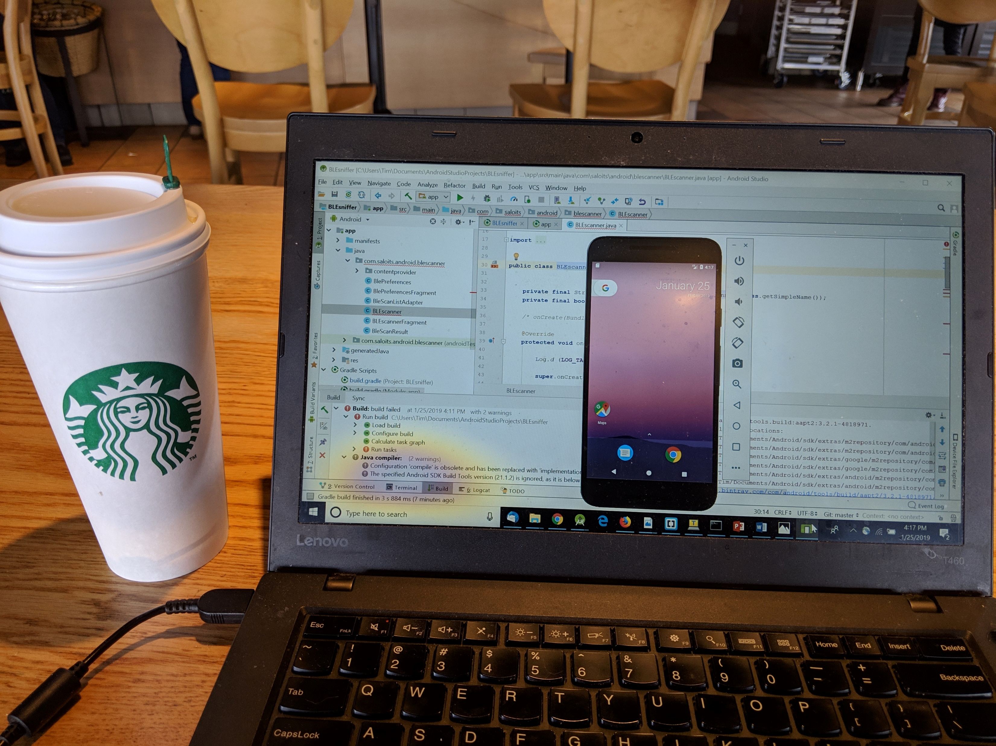
Interfacing Android Things: Observations
Mobile Developer

Slide 49
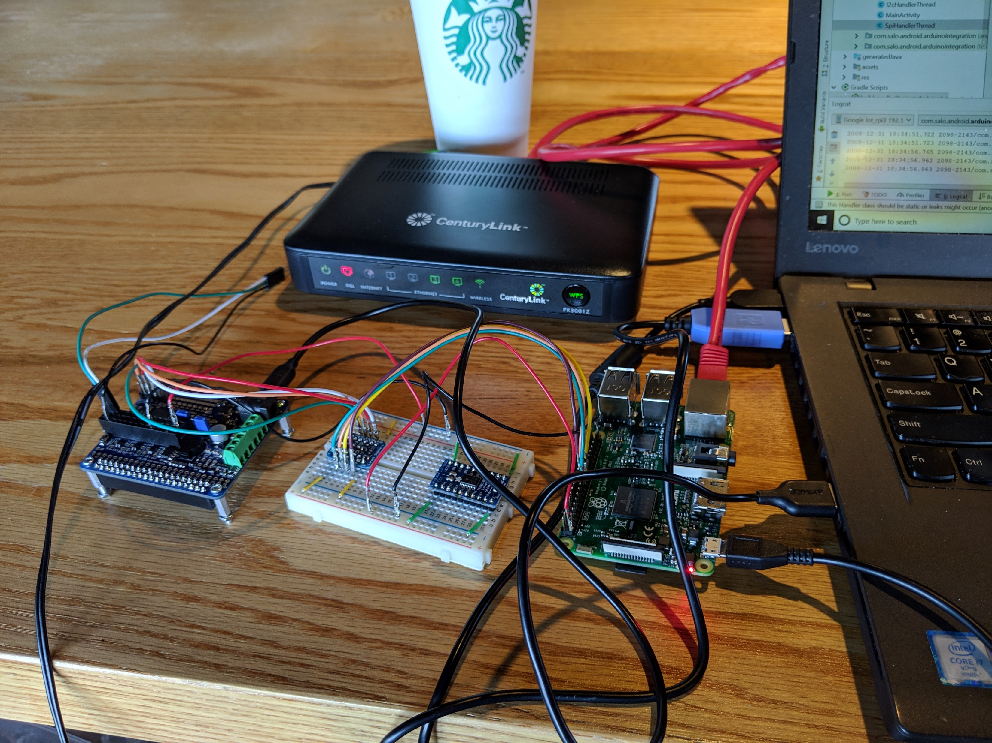
Interfacing Android Things: Observations
Embedded Developer

Slide 50
Interfacing Android Things: Observations
Whither Android Things?
Will Android Things become a useful tool for embedded programming?
I would love to see Android Things become brilliantly successful
But…

Slide 51
Interfacing Android Things: Observations
Whither Android Things?
Will Android Things become a useful tool for embedded programming?
Current focus on big iron
Multi-core, GHz processors with half-a-gigabyte or more
Seems unlikely to ever be useful for MCUs
Useful on generic CPUs?
Useful outside of Google ecosystem?

Slide 52
Interfacing Android Things: Observations
Whither Android Things?
Will Android Things become a useful tool for embedded programming?
Tied to Google ecosystem
Focus appears to be on smart displays (large and small) and home automation hubs

Slide 53
Interfacing Android Things: Observations
Whither Android Things?
Will Android Things become a useful tool for embedded programming?
In my view, Google needs an edge computing solution
Important for Google IoT Cloud

Slide 54
Interfacing Android Things: Observations
Whither Android Things?
Will Android Things become a useful tool for embedded programming?
Lots of competition in these spaces
Even within Google
Chrome
Fuchsia
Cloud IoT Edge / Linux

Slide 55
Interfacing Android Things
Android Things “Makes embedded development as simple as mobile development has become”
- Dave Smith, Google I/O 2017
While the Android Things ecosystem demonstrates some potentially useful capabilities, it is no panacea for the challenges that face embedded developers.
- Tim Salo, IoT Devfest 2019

